Slide 1



Britpop and the Sounds of the Nineties:
Exploring Pulse and Rhythm
Year Group:
2
Unit Number:
3

Slide 2






For all of our plans in this unit, we have three areas of teaching: a focus activity, the main content and a plenary. These areas can be identified by a different border colour to the background.
Plan & Unit Guidance
Focus Activity
Main Content
Plenary
Different icons for audio and video will appear that allow you to interact with the content. Icons will work by hovering over them and then clicking the play button that appears underneath.
Play Audio Track
Play Video

Slide 3

Lesson 1

Slide 4
Learning Objective(s):
All children will understand that pulse is a consistent beat.
Listening Focus:
Don’t Look Back in Anger by Oasis

Slide 5
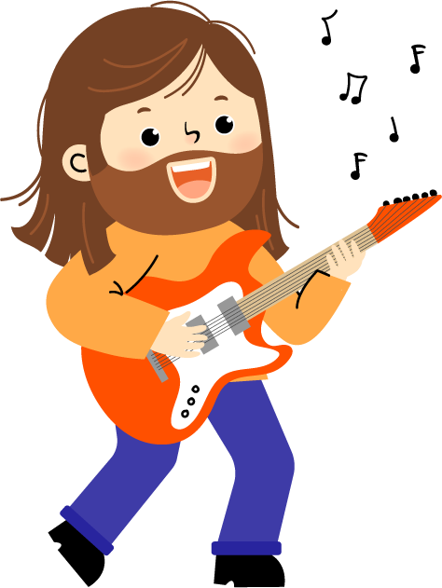
Introducing ‘Britpop and the Sounds of the Nineties’
This half term, we will be studying pop songs from the 1990s.
You might have heard these on adverts, supermarket radio stations, smart speaker playlists, as background music for television programmes and more.
We are going to focus on British bands who were famous during the Britpop era, a time in the mid-1990s when there were lots of extremely successful British pop and rock bands.

Slide 6
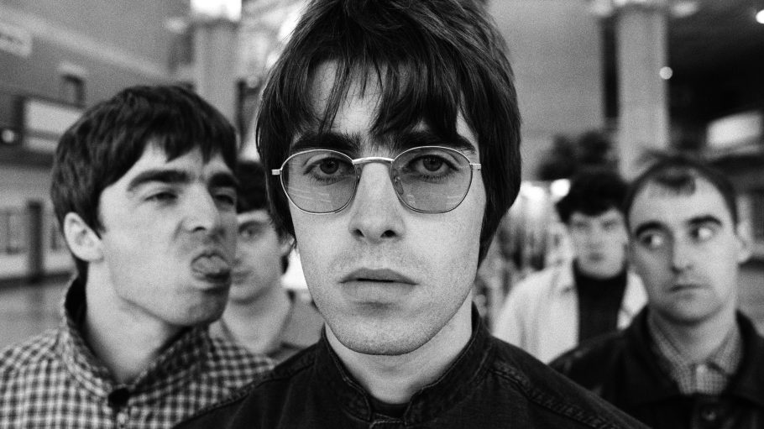
Oasis
Oasis were a British rock band who were most active during the 1990s and 2000s.
The band were fronted by two brothers from Manchester called Noel (left) and Liam (right) Gallagher.
Famously, the brothers were always arguing and eventually the band split up because of their constant arguments.

Slide 7
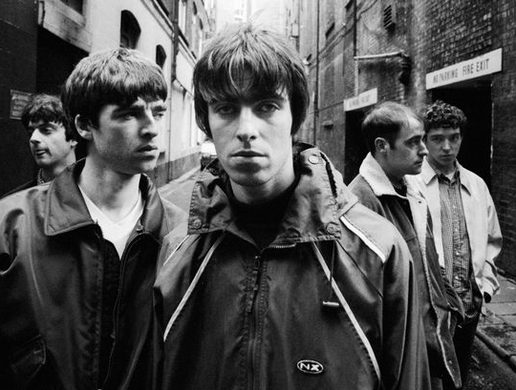
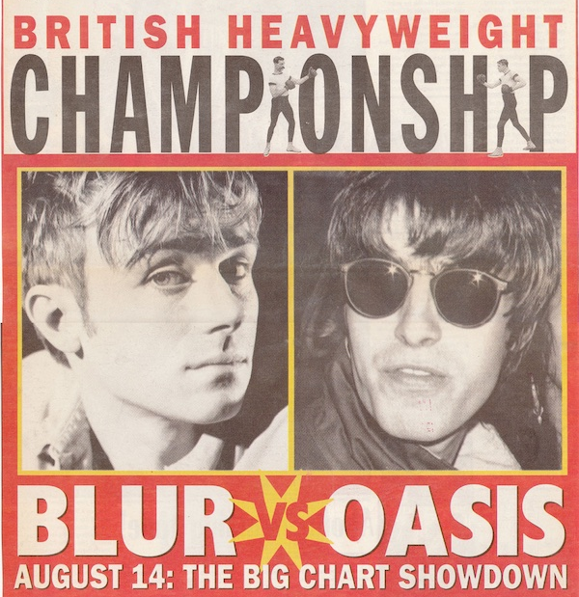
Oasis
Their most famous album was released in 1995 which shot to number 1 in the charts and stayed in the top three for over a year.
During this time Oasis were at war with another British rock band called Blur who also released a popular album in 1995 and this led to the newspapers calling it the Battle of Britpop.

Slide 8
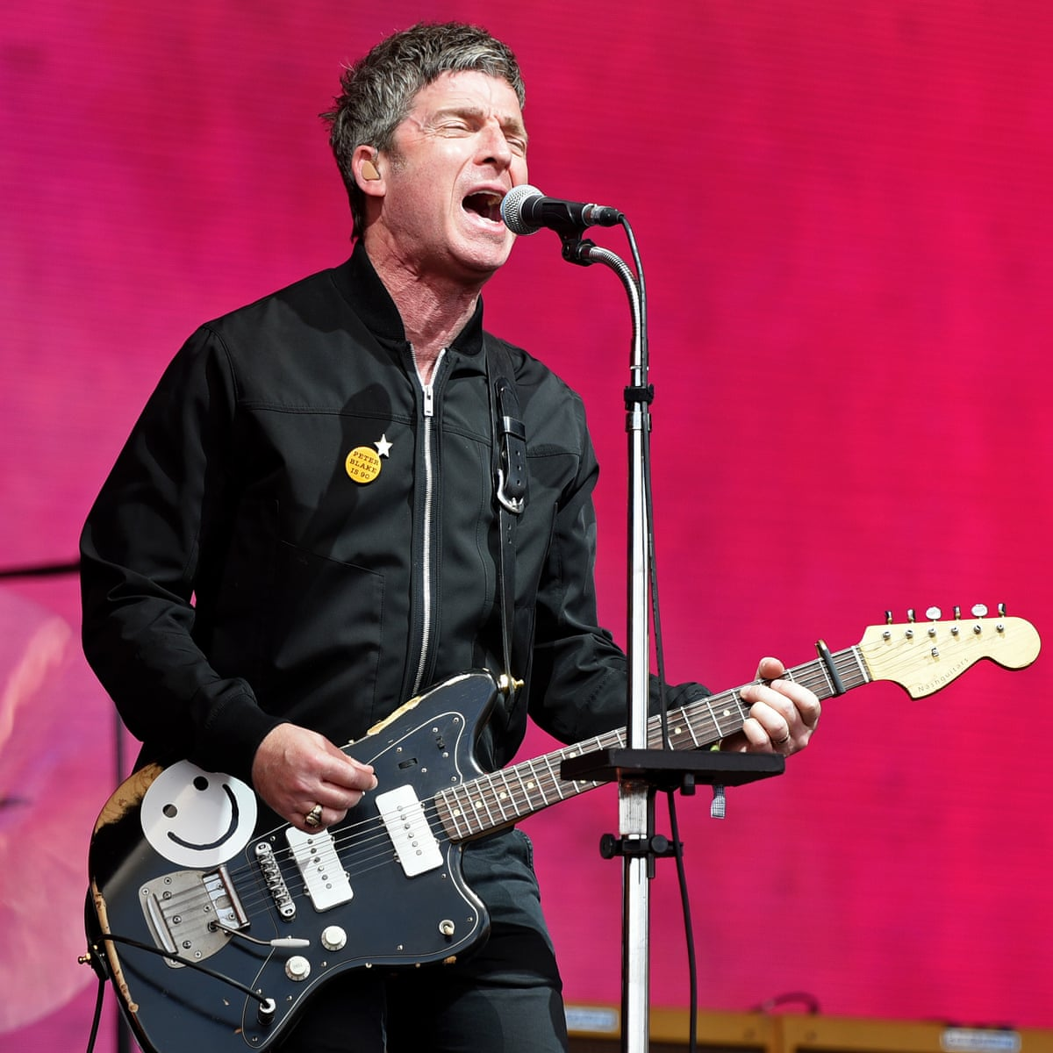
‘Don’t Look Back in Anger’
‘Don’t Look Back in Anger’ is perhaps Oasis’ most famous hit and sold 2,400,000 copies upon its initial release in 1996.
It was unusual for an Oasis song as it was sung by their lead electric guitarist, Noel Gallagher, instead of their usual singer, his brother Liam Gallagher.
Noel Gallagher not only played electric guitar, but he also wrote the vast majority of Oasis songs.
He is widely recognised as one of the greatest songwriters of the 1990s and also one of the best guitarists to come out of this period as well.

Slide 9

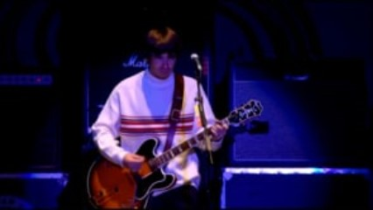
‘Don’t Look Back in Anger’
by Oasis

Slide 10
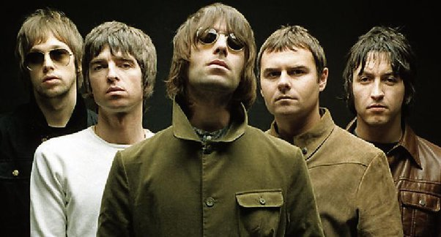
‘Don’t Look Back in Anger’ Listening Question Prompts
Let’s discuss the song.
Do you like it?
How does it make you feel? Is it happy or sad?
Can you dance to it?
Have you heard it before? Where might you have heard it?
What instruments can you see and hear?

Slide 11

What is the Beat or Pulse?
The beat or pulse is like a clock or the heartbeat of the music. It is what underpins the music and is a steady march that you can do to any piece of music.
Let’s say this sentence altogether:
The pulse or beat is what you can clap along to.

Slide 12


What is the Beat or Pulse?

Slide 13
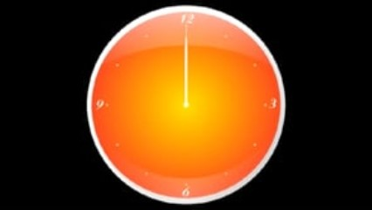
Playing Along with the Pulse

Slide 14
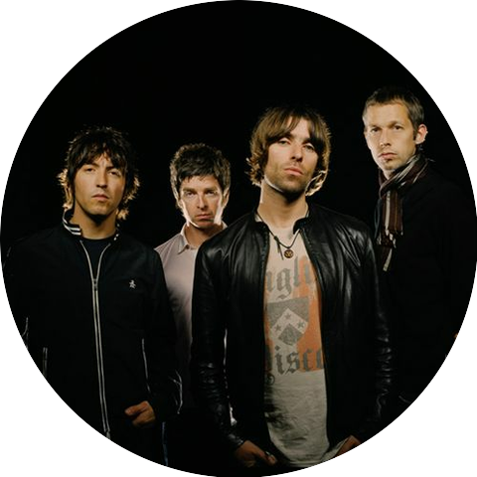
Don’t Look Back in Anger
So Sally can wait
She knows it’s too late
As were walking on by
Her soul slides away
But don’t look back in anger
I heard you say.
So Sally can wait
She knows it’s too late
As she's walking on by
My soul slides away
But don’t look back in anger
Don’t look back in anger
I heard you say.

Slide 15
How to Hold a Beater

Slide 16

How to Hold a Beater
What we don’t want to see:
balled fists – like you’re about to throw a punch,
an outstretched finger – like you’re pointing or telling someone off,
upside down and pointing downwards – like you’re holding a pencil.

Slide 17
Playing Along with the Pulse

Slide 18


Keep to the Steady Beat

